Slide 1
Cataloging Q & A
August 20, 2:00 PM

Slide 2
Correction
Using a set to run a job in Alma
Logical sets
Itemized sets
All OK

Slide 3
Topics
Batch deletion of holdings on Connexion
Run a job to link IZ records to NZ
Linking record between IZ and NZ
no IZ record – link NZ record to IZ
with IZ record – share with Network
Unlink IZ records from NZ (break the NZ link)
Resolving duplicate records
Electronic holdings not activated (inactive portfolios – not available)
Other IZs records loaded into local IZ

Slide 4
Delete Holdings on WorldCat via Connexion
Why?
Alma publishing job
To attach holdings for new titles
Does NOT cancel holdings for withdrawn titles – Manual work is expected
Cancel holdings can be done one by one or in batch

Slide 5
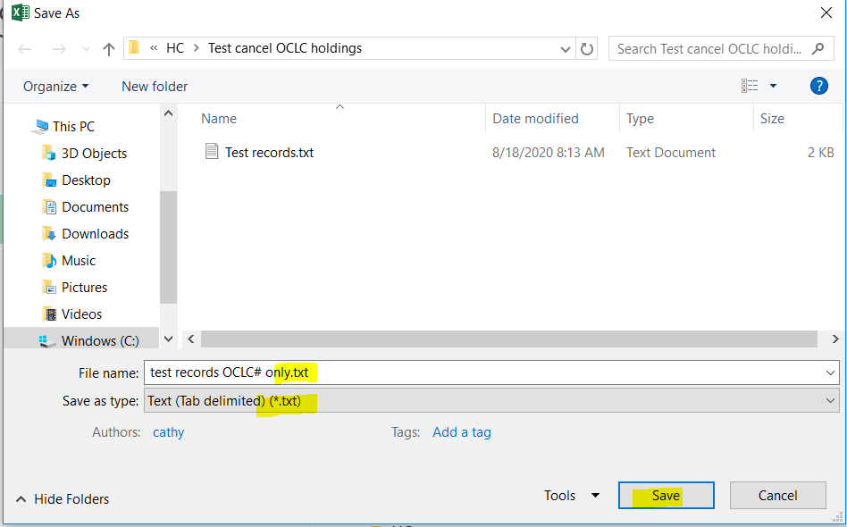
Move the OCLC# column to a new sheet and save a .txt file

Slide 6
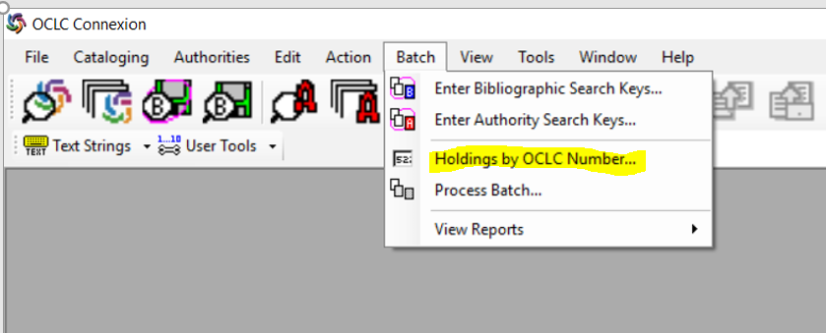
OCLC Connexion Client – Holdings by OCLC Number

Slide 7
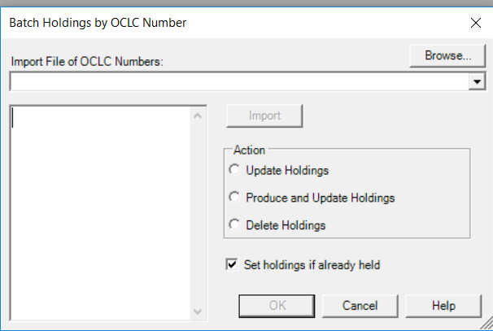
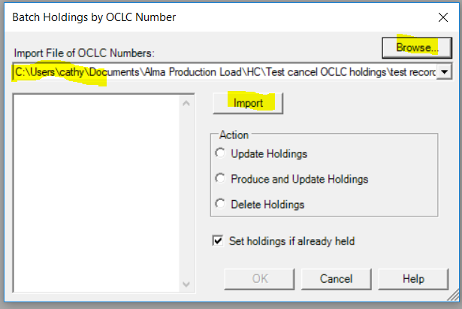
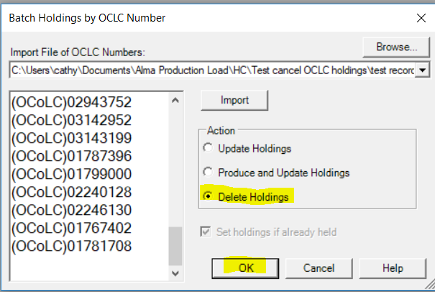

Slide 8
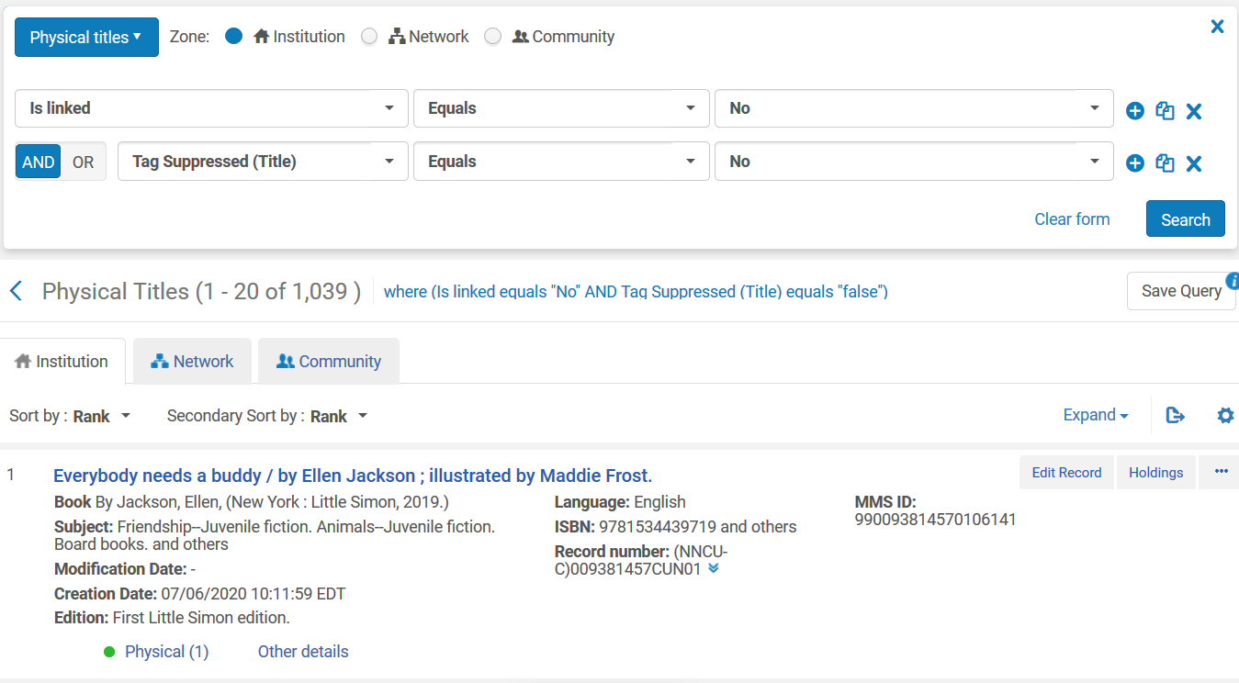
Records not linked to NZ
Notes:
Multi_Match records resolved, to move on to other unlinked records

Slide 9
Records not linked to NZ – Resolve in batch with a job
Resolve unlinked records by category, filter out local records that should not be linked to NZ
Equipment, personal copy on reserve, local leisure ready collection
Leave records in a set that should be linked to NZ
Run a job to batch link to NZ

Slide 10
Linking Records between IZ and NZ (one by one)
Record only in NZ
Record in IZ (with or without records in NZ)

Slide 11
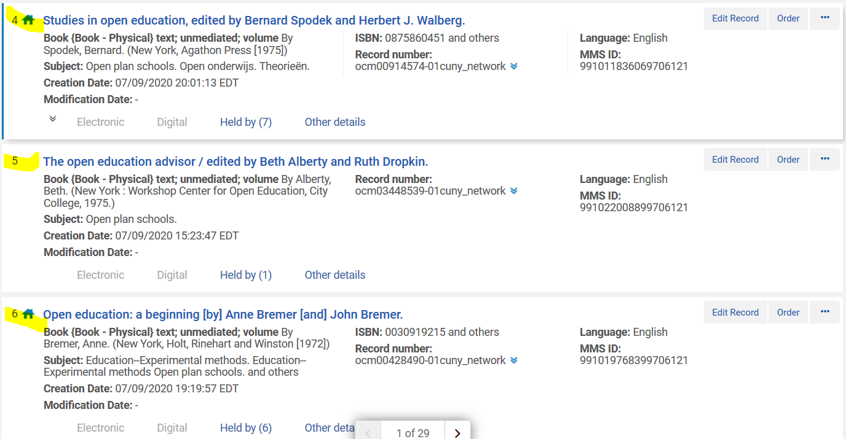
Record only in NZ (new titles)
Click title to go to record view

Slide 12
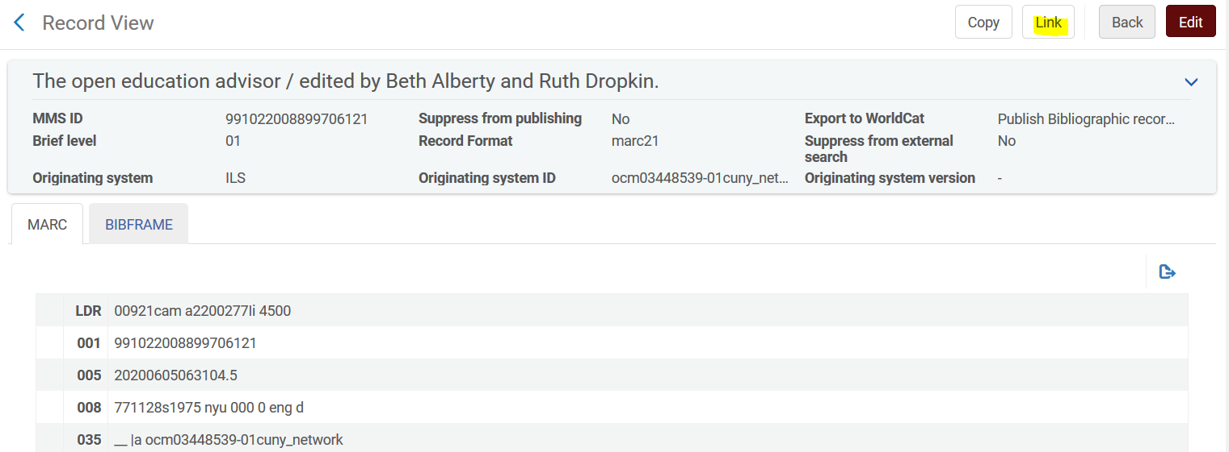
From MARC Record View page, click “Link”

Slide 14
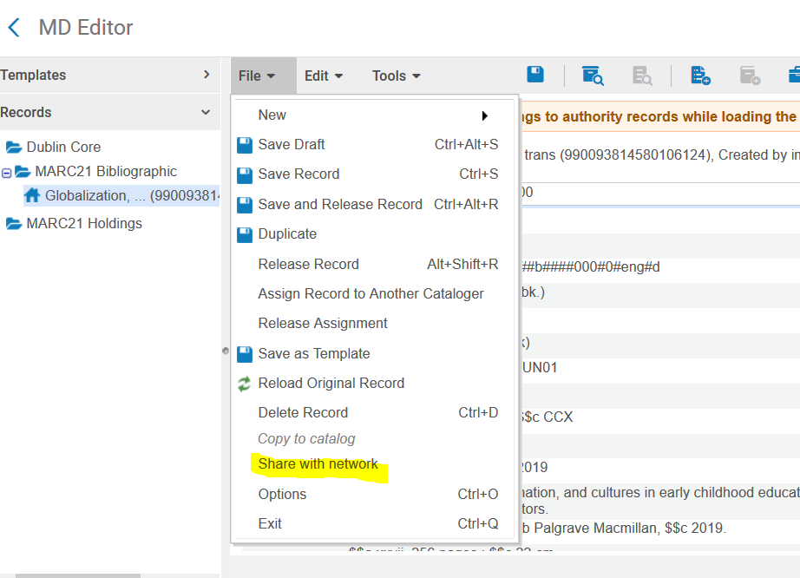
Records in IZ – to link to NZ (Share with network)

Slide 15
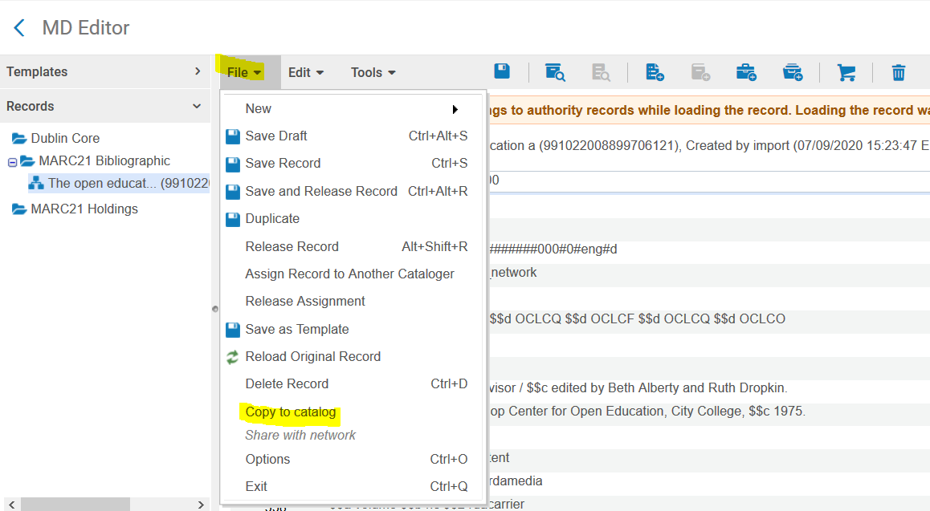
To Unlink IZ and NZ (Break the link) Open IZ record in MD Editor
Click “Copy to catalog” and save record to IZ. You can then delete the IZ record.

Slide 16
Records unlinked in IZ
Can remain unlinked (e.g., circ-created records)
Can be deleted (all items have been withdrawn)

Slide 17
Electronic Title – Resolving Inactive Portfolios
Electronic portfolios with no url link

Slide 18
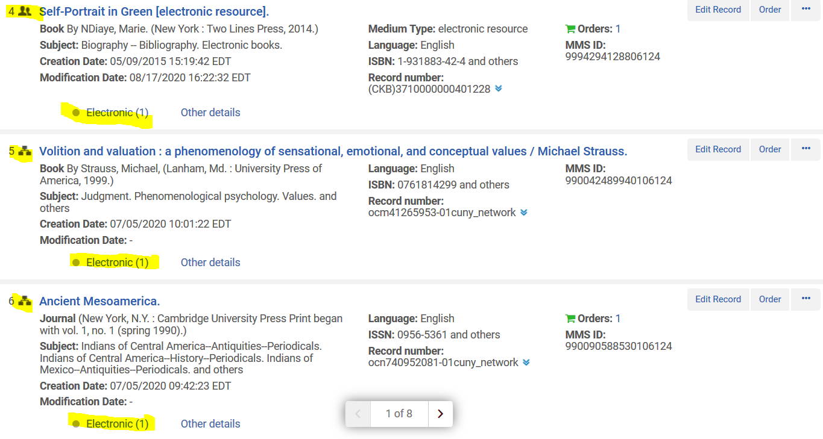
Inactive electronic holdings
Start with records linked to NZ
Open Electronic holdings

Slide 19
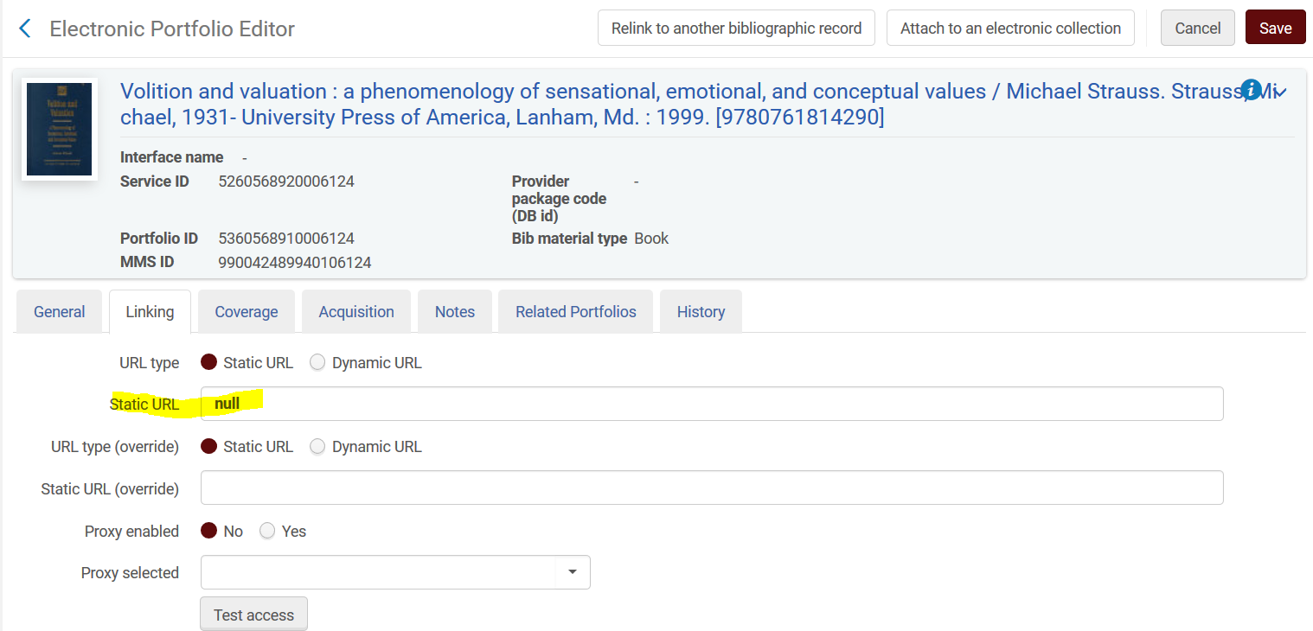
No url in the Portfolio record
Need to find and enter valid url from:
Bib record (856 field)
MD Editor – View original record
Locate 856 url from Aleph record
Locate 856 url from OCLC record
Ask your e-resources librarian

Slide 20
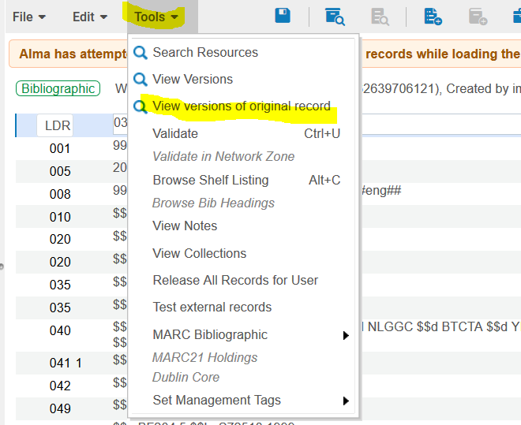
View versions of original record

Slide 21
Use Aleph System id to look up record in Aleph
Aleph System ID in Alma (952 field)

Slide 22
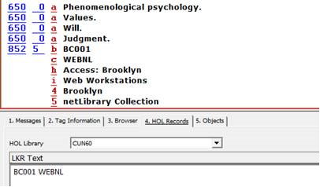
No 856 in Original Aleph Record (NetLibrary ebook)
Use Aleph System id to look up record in Aleph

Slide 23
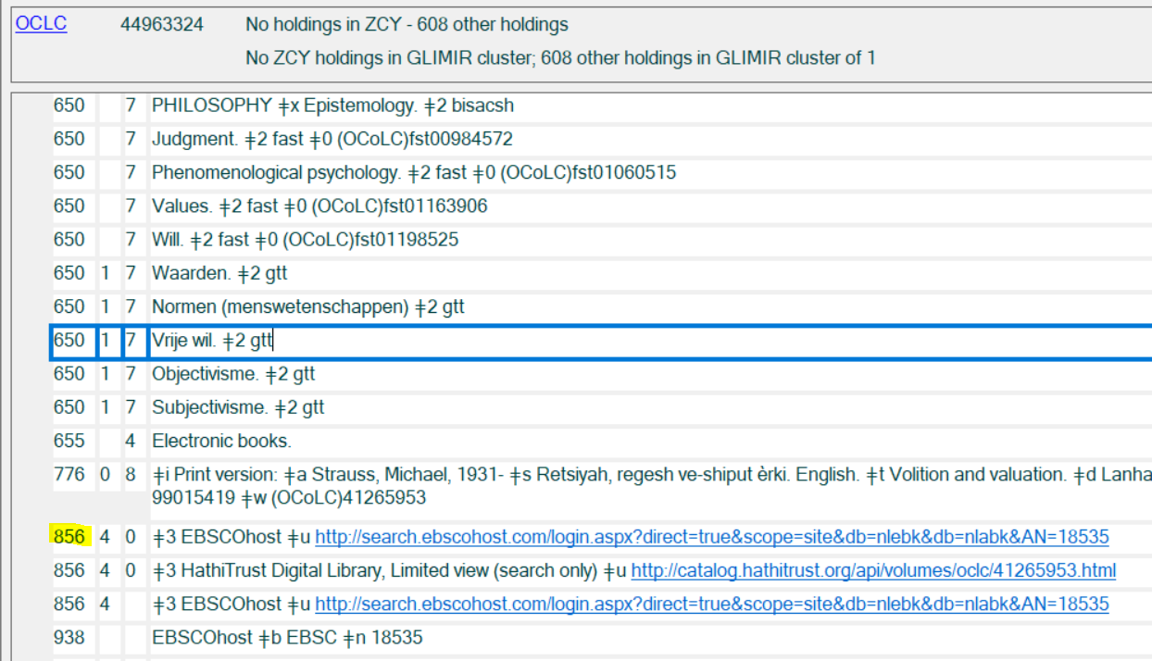
Locate 856 from OCLC record -

Slide 24
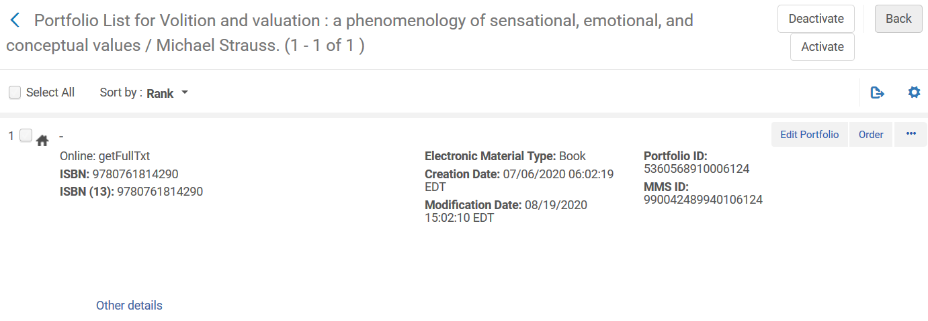
When 856 is located and copied
Click “Portfolio list” to open record
Click Edit Portfolio to edit record

Slide 25
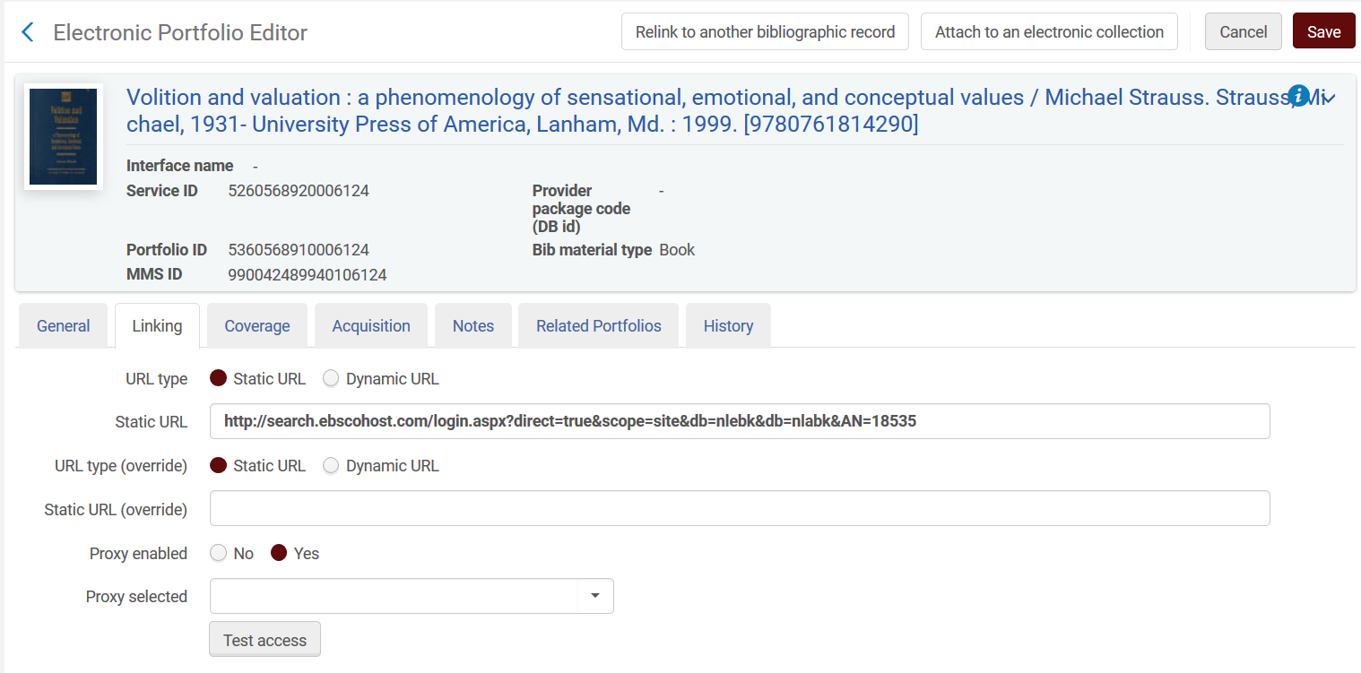
Enter the url, Enable the Proxy and click “Save”
Enter the url
Test access making sure the url works

Slide 26
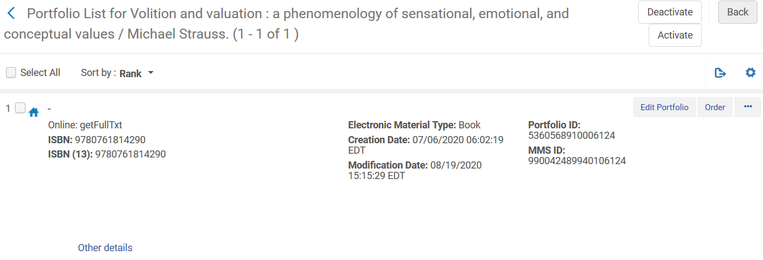
After the portfolio record is saved, Alma will take you
back to the Portfolio List
Select and activate the resource
Source Activated

Slide 27
Electronic Resource Became Active

Slide 28
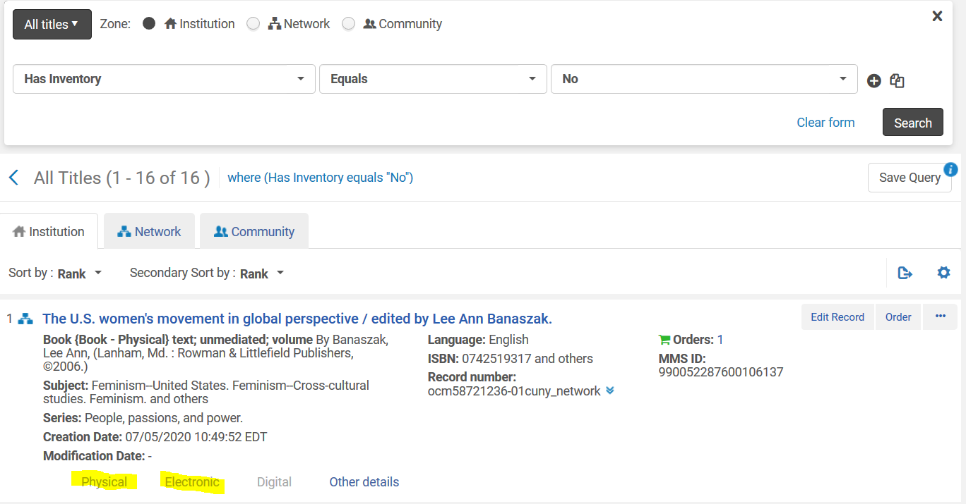
Resolved Records with no Inventory
To find/enter holdings; or
To Delete

Slide 29
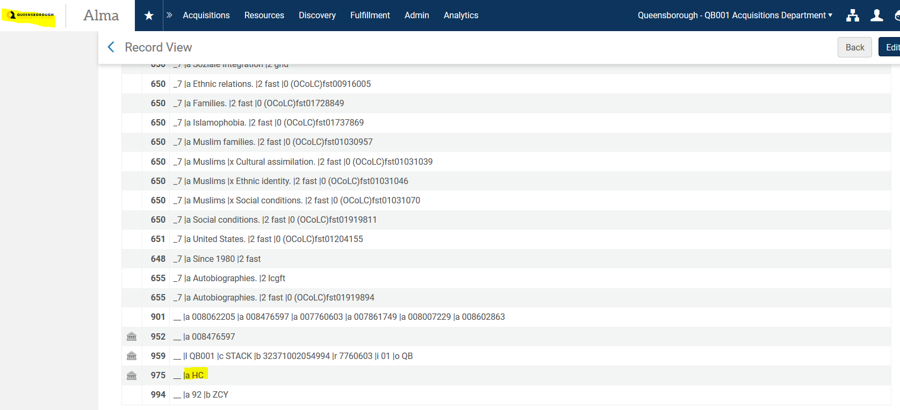
HC Records loaded into QB IZ – Examine/confirm/delete

Slide 30
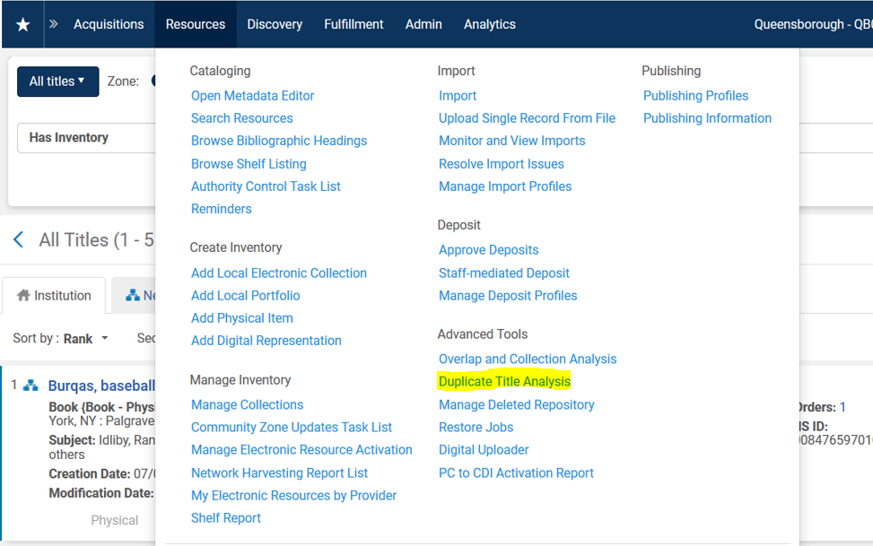
Alma Duplicate Title Analysis

Slide 31
Locate records with identical OCLC# in 035
Click History to locate report

Slide 32
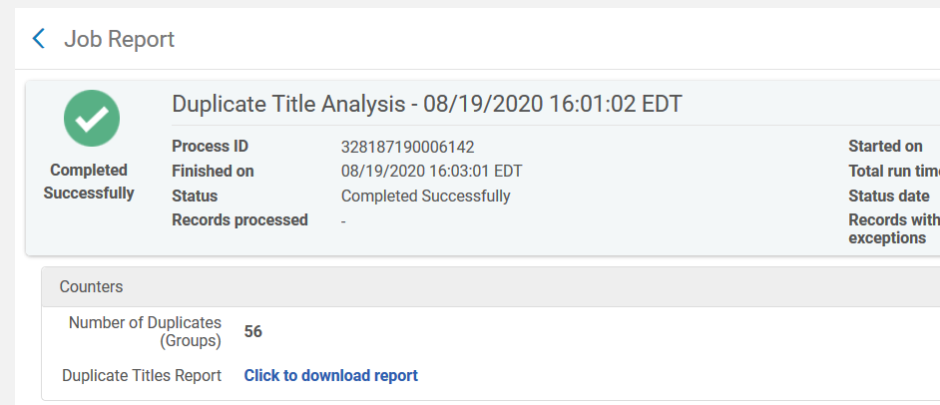
Retrieve report of duplicate titles

Slide 33
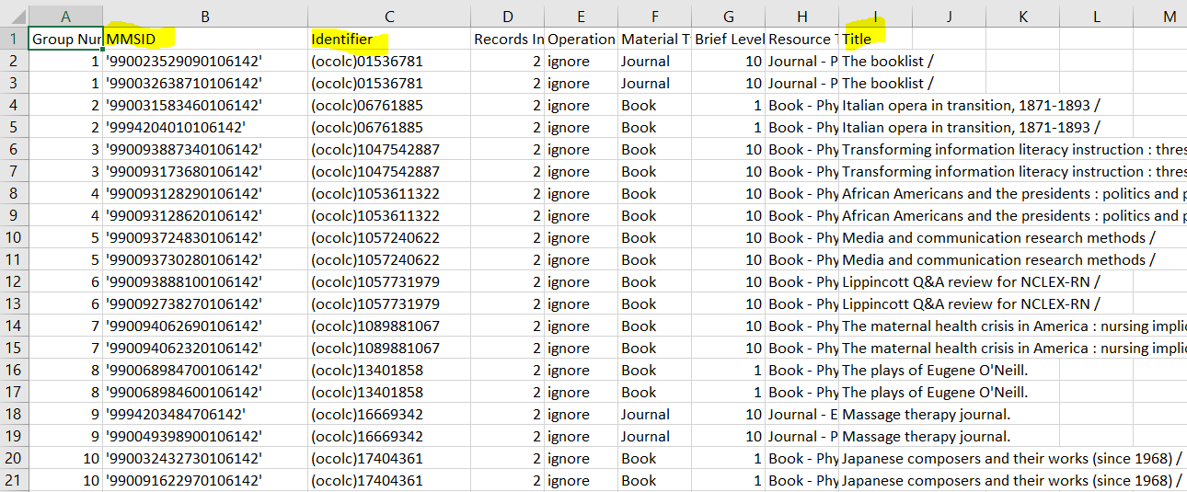
Duplicate titles on Excel – To resolve

Slide 34
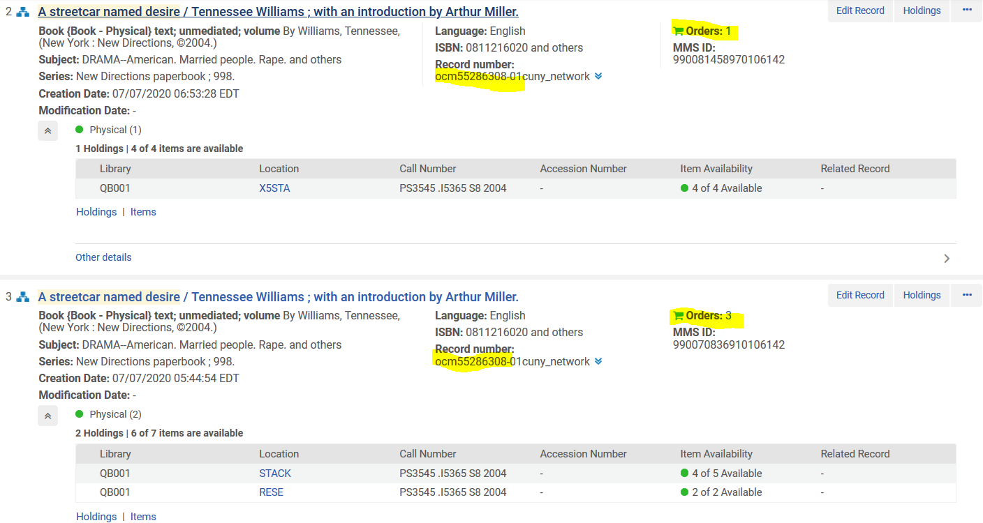
Duplicate Records in Alma – Different locations

Slide 35
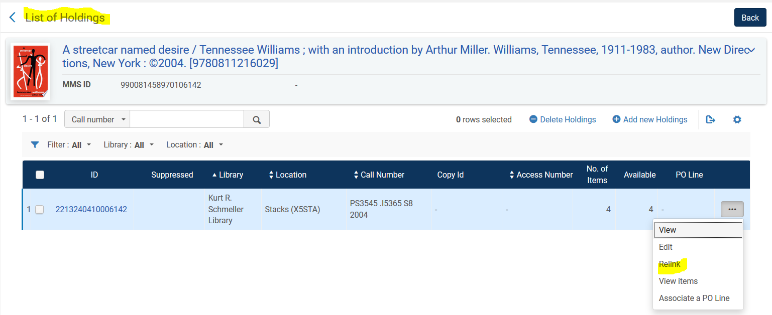
Relink Records from Holdings

Slide 36
In MD Editor

Slide 37
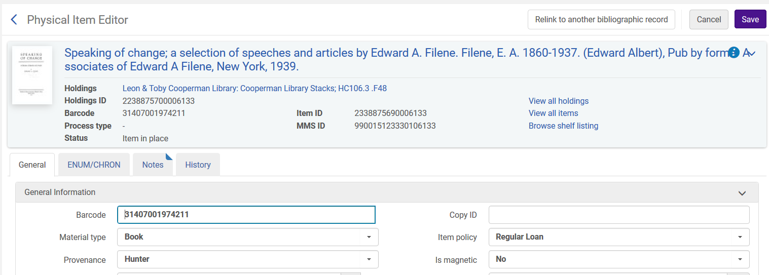
Relink from the Item Record

Slide 38
Search and Select the Record to link to

Slide 39
Questions

